Slide 1


Using SQL Queries
From analyzing the Seattle Mariner’s player statistics to running a small produce store. Databases are needed everywhere!

Slide 2

Sports have an endless amount of data…
Sports data is always used by teams to make the toughest decisions.
Teams want to be the best, and if they can’t find their problems, how are they going to fix them?
Want to pay players with incentives? Owners set statistical goals that players need to meet in order to make the big bucks!
How else can you strategize against other teams? Find their weaknesses within the data!
There’s an endless amount of ways data can be used, WE NEED IT!

Slide 3
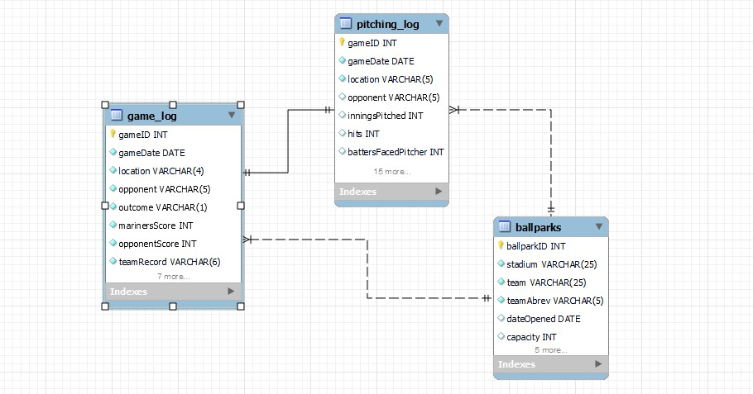

Looking at the 2022 Mariners:
The Mariners had a breakout season in 2022, making the playoffs for the first time since 2001! Let’s analyze out how they made that happen.

Slide 4
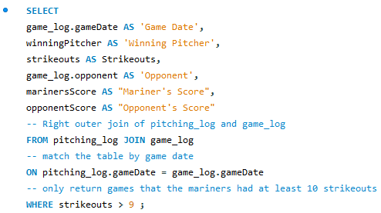

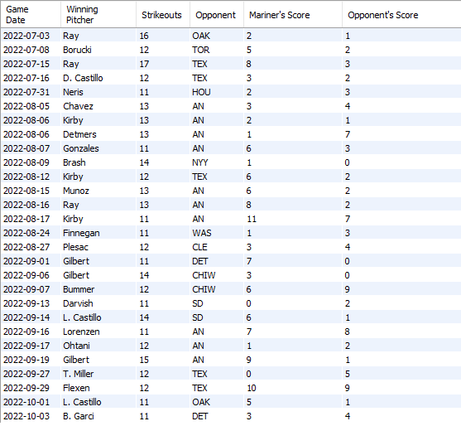
Mariner’s pitching in 2022 was UNSTOPPABLE. Let’s take a look:
We can join our game_log and pitching_log to show games the Mariners pitched 10+ strikeouts.

Slide 5
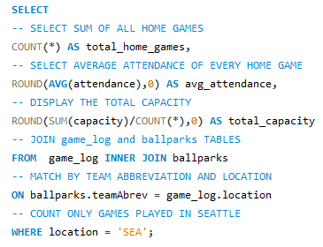

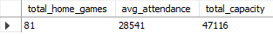
Mariner’s Success Would Not Go Unnoticed
When using a join statement with some simple summary queries, we can find the average attendance for games played in Seattle.
The Mariners finished top 15 in attendance for 2022!

Slide 6
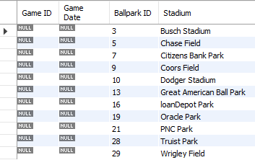
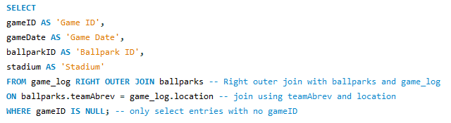
Outer Join Queries
Using an outer join, we can find missing data between two tables (ballparks and game_log).
The results table shows us that we are missing game results for each of these stadiums. This concludes that the Mariners never played a game at those stadiums in 2022!

Slide 7
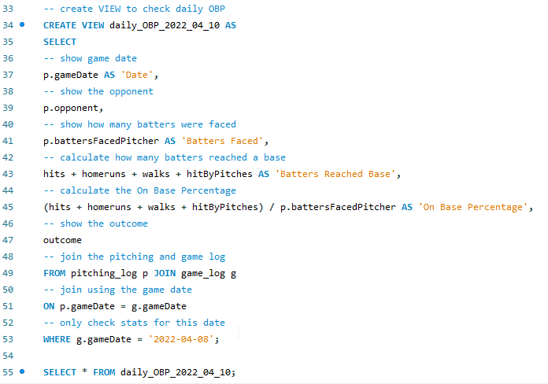

Keeping Track of Opponent’s On Base Percentage
Using a View, we can keep track of daily OBP with the same select statements AND we can use previous views just like any other table to analyze more data!
I’ve been tasked of checking the daily opponent’s on base percentage and reporting it back to the club house after every game…

Slide 8

Database Importance In Businesses
Provide a structured way to organize and manage business data.
Allows businesses to personalize customer experience, target marketing campaigns, and enhance satisfaction.
Provide scalability and growth allowing the ability to handle more data as time goes on.
Provide support to management especially with adhering to employee needs.

Slide 9
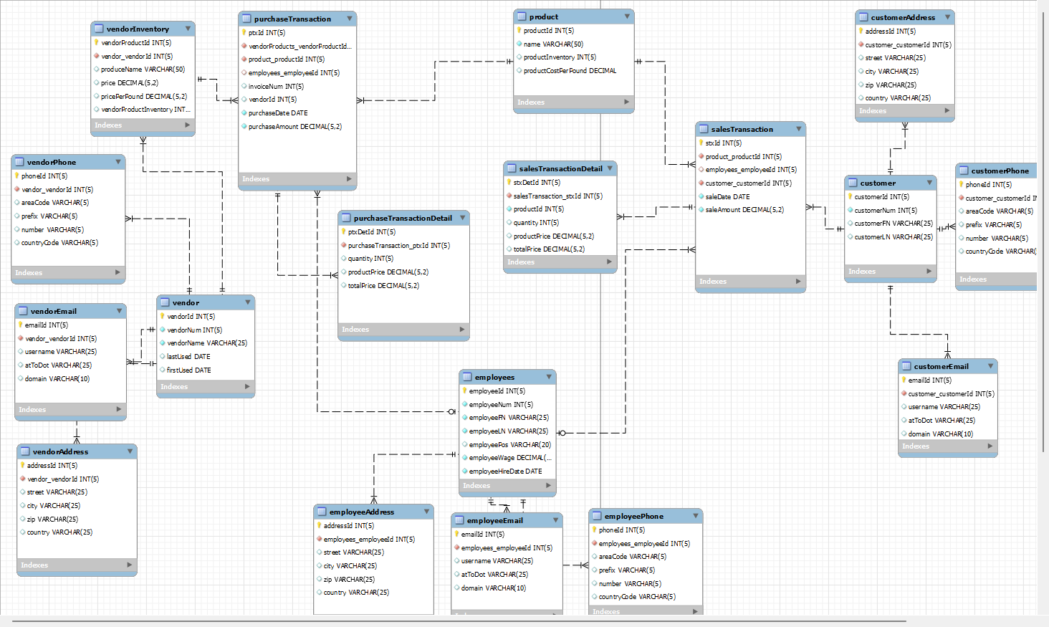
Database Structure In Business
Database structure is determined by the needs of a business.
It’s also important to make proper relationships between tables:
In the case of opening a small produce store, I need to keep track of lots of data including:
Customers
Employees
Vendors
Vendor Transactions
Customer Transactions
Product Inventory
And more…

Slide 10


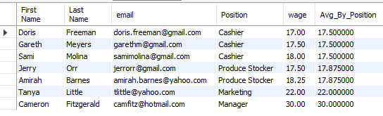
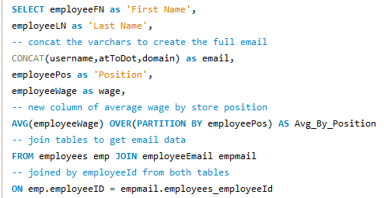
A Business Can’t Run Without Employees!
Employees are the heart of a business, so we need to take care of them!
With simple summary queries, joins, and an OVER statement…
I can check on my employees, and make sure they are being paid fairly. We can see average wages by position along side current personal wages!

Slide 11

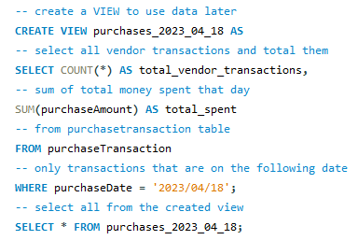
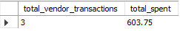
Managing Money With Databases
Without organization or attention to purchases/sales, businesses risk losing money!
Data like this can now be used for later queries/analysis!

Slide 12
To Conclude…
SQL is powerful and is the most popular/preferred language for databases worldwide.
Databases have endless capabilities in the field of business/data management and serve as the backbone of modern information systems.
Learning SQL is a valuable skill for anyone involved in data analysis, database administration, and software development!

